Slide 1
Chapter 4 Induction and Recursion
4.1 Mathematical Induction
4.2 Strong Induction and Well-ordering
4.3 Recursive Definition and Structural Induction
4.4 Recursive Algorithms

Slide 2
4.4 Recursive Algorithms
An algorithm is called recursive if it solves a problem by reducing it to an instance of the same problem with smaller input.

Slide 3
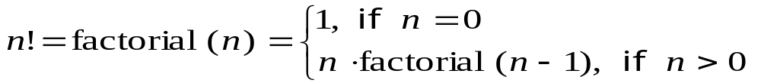
4.4 Recursive Algorithms
〖Example 1〗 Give a recursive algorithm for computing the factorial function n! .
Algorithm 1 A Recursive Procedure for Factorials.
procedure factorial(n: positive integer)
{
  if n=0 then
  factorial(n):=1
  else
  factorial(n) := n×factorial(n-1)
}

Slide 4
4.4 Recursive Algorithms
〖Example 2〗 Express the linear search algorithm as a recursive procedure.
Algorithm 3 A Recursive Linear Search Algorithm).
procedure search(i, j, x: i, j, x integers, 1≤ i, j ≤ n)
{
  if a_{i}=x then
  location:=i
  else if i=j then
  location:=0
  else
  search(i+1, j, x)
}

Slide 5
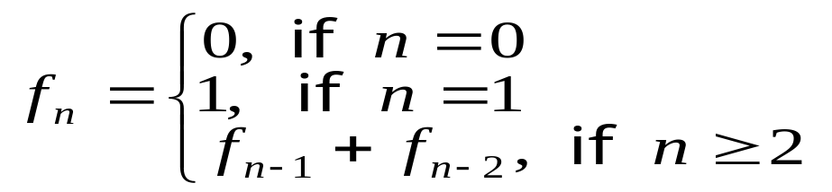
4.4 Recursive Algorithms
〖Example 3〗 Give a recursive algorithm for Fibonacci Numbers
Algorithm 4 A Recursive Procedure for Fibonacci Numbers.
procedure fibonacci(n: nonnegative integer)
{
if n = 0 then fibonacci(0) :=0
else if n = 1 then fibonacci(1) :=1
else fibonacci(n) := fibonacci(n-1) + fibonacci(n-2)
}

Slide 6
4.4 Recursive Algorithms
Algorithm 5 An Iterative Procedure for Computing Fibonacci Numbers.
procedure iterative fibonacci(n: nonnegative integer)
if n = 0 then y:= 0
else
begin
x:=0
y:=0
for i:=1 to n-1
begin
z:=x+y
x:=y
y:=z
end
end
{y is the nth Fibonacci number}

Slide 7
4.3 Recursive Definition and Structural Induction
Recursive algorithm vs. iterative algorithm
For every recursive algorithm, there is an equivalent iterative algorithm.
Recursive algorithms are often shorter, more elegant, and easier to understand than their iterative counterparts.
However, iterative algorithms are usually more efficient in their use of space and time.

Slide 8
Homework: (Due on April 13)
Ver. 8 & Ver. 7
Sec. 5.4 29

